Slide 1
Cyclic groups & galois fields

Slide 2
Objectives
To define and give some examples of groups
To define and give some examples of fields
To emphasize the finite fields of type GF (2^{n}) that make it possible to perform operations such as addition, subtraction, multiplication, and division on n-bit words in modern block ciphers
<modern symmetric-key ciphers are based on algebraic structure>

Slide 3
Groups
A group (G) is a set of elements with a binary operation (•) that satisfies four properties.
Closure
Associativity
Existence of identity
Existence of inverse

Slide 4
Groups(cont.)
Closure
If a and b are elements of G, then c = a•b is also an element of G.
Associativity
If a, b and c are elements of G, then (a•b) •c=a•(b•c)
Existence of identity
For all a in G, there exist an element e, called the identity element, such that e•a=a•e=a
Existence of inverse
For each a in G, there exists an element a’, called the inverse of a, such that a•a’=a’•a=e

Slide 5
Groups(cont.)
A Commutative group (Abelian group), is a group in which the operator satisfies four properties plus an extra property that is commutativity.
For all a and b in G, we have a • b = b • a

Slide 6
Groups(cont.)
Although a group involves a single operation, the properties imposed on the operation allow the use of a pair of operations as log as they are inverses of each other.
If the defined operation is addition, the group supports both addition and subtraction, because subtraction is addition using the additive inverse.
This is also true for multiplication and division.
However, a group can support only addition/subtraction or multiplication/division operations, but not the both at the same time.

Slide 7
Groups(cont.)
Example
The set of residue integers with the addition operator,
G = < Zn , +>,
is a commutative group.
Check the properties…..
Assume- a=2, b=3, c=4, and identity element is 0

Slide 8
Example (cont..)
Closure is satisfied. The result of adding two integers in Zn is another integer in Zn.
Associativity is satisfied. The result of 4+(3+2) is same as (4+3)+2.
Commutativity is satisfied. We have 3+5=5+3.
The identity element is 0. we have 3+0=0+3=3.
Every element has an addititive inverse. The inverse of a element is its complement. For example, the inverse of 3 is -3 (n-3 in Zn) and the inverse of -3 is 3. the inverse allows us to perform subtraction on the set.

Slide 9
Groups(cont.)
Example:
The set Zn* with the multiplication operator, G = <Zn*, ×>, is also an abelian group.
We can perform multiplication and division on the elements of this set without moving out of the set.
Example:
Let us define a set G = < {a, b, c, d}, •> and the operation as shown in Table.

Slide 10
The group is abelian????
Closure ?
Associativity?
Commutativity?
The group has an identity element, which is a.
Each element has an inverse. The inverse pairs can be found by finding the identity in each row (shaded). The pairs are (a,a), (b,d), (c,c).

Slide 11
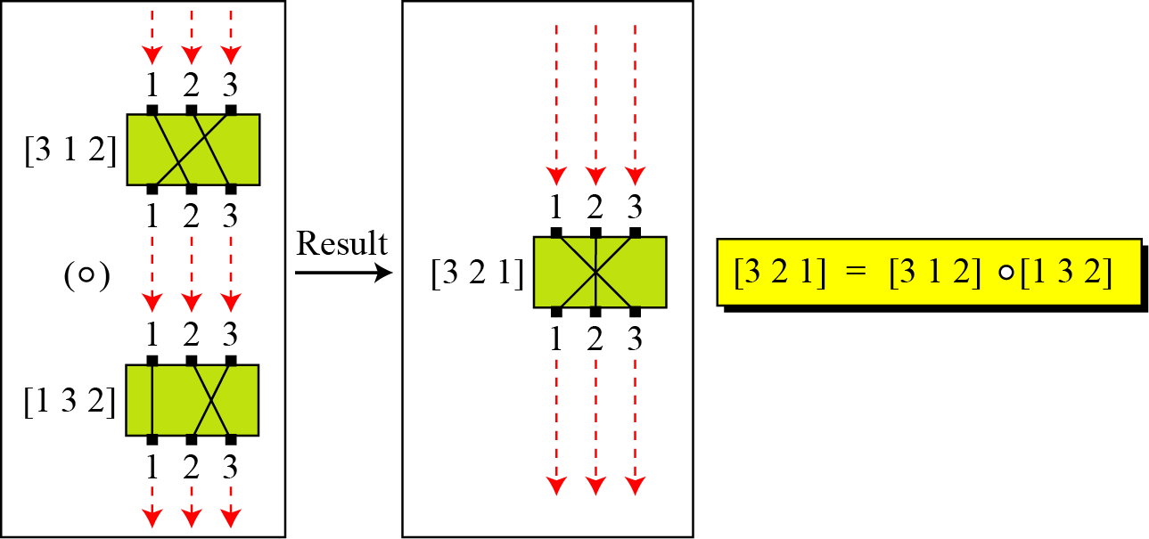
Groups(cont.)
Example:
A very interesting group is the permutation group.
The set is the set of all permutations, and the operation is composition: applying one permutation after another.
Check for properties….
Is the group abelian???
Composition of two permutations

Slide 12
Groups(cont.)
Example(cont.):
Operation table for permutation group
With three inputs and three outputs, there can be 3! or 6 different permutations.
Only four properties are satisfied.
Closure
Associativity.
Commutative?
The set has an identity element, which is [1 2 3].
Each element has inverse.

Slide 13
Groups(cont.)
Finite Group
If the set has a finite number of elements; otherwise, it is an infinite group.
Order of a Group |G|
The number of elements in the group.
If the group is finite, its order is finite
Subgroups
A subset H of a group G is a subgroup of G if H itself is a group with respect to the operation on G

Slide 14
Groups(cont.)
Subgroups(cont.)
If G=<S, •> is a group, H=<T, •> is a group under the same operation, and T is a nonempty subset of S, then H is a subgroup of G
The above definition implies that:
If a and b are members of both groups, then c=a•b is also member of both groups
The group share the same identity element
If a is a member of both groups, the inverse of a is also a member of both groups
Each group is a subgroup of itself

Slide 15
Groups(cont.)
Exercise:
Is the group H = <Z₁₀, +> a subgroup of the group G = <Z₁₂, +>?

Slide 16
Groups(cont.)
Exercise:
Is the group H = <Z₁₀, +> a subgroup of the group G = <Z₁₂, +>?
Solution:
The answer is no. Although H is a subset of G, the operations defined for these two groups are different. The operation in H is addition modulo 10; the operation in G is addition modulo 12.

Slide 17
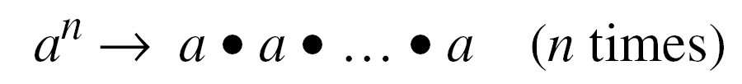
Groups(cont.)
Cyclic subgroups
If a subgroup of a group can be generated using the power of an element, the subgroup is called the cyclic subgroup.
The term power here means repeatedly applying the group operation to the element.

Slide 18

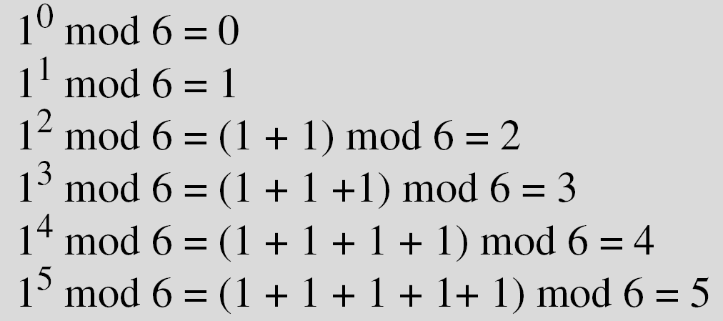
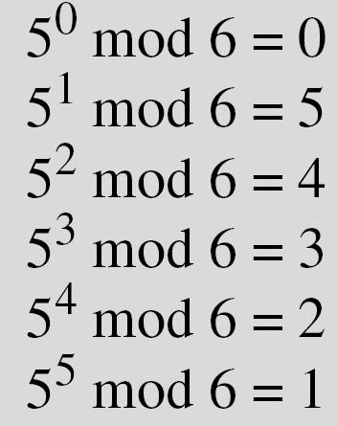
Groups(cont.)
Four cyclic subgroups can be made from the group G = <Z₆, +>.
They are H₁ = <{0}, +>, H₂ = <{0, 2, 4}, +>, H₃ = <{0, 3}, +>, and H₄ = G.

Slide 19
Groups(cont.)
Exercise:
Find out the cyclic subgroups for group G = <Z₁₀∗, ×>.

Slide 20
Groups(cont.)
Three cyclic subgroups can be made from the group G = <Z₁₀∗, ×>. G has only four elements: 1, 3, 7, and 9. The cyclic subgroups are H₁ = <{1}, ×>, H₂ = <{1, 9}, ×>, and H₃ = G.

Slide 21
Groups(cont.)
Cyclic group
The group G has a cyclic subgroup H₄ = G . This means that the group G is a cyclic group.
In this case, the elements that generates the cyclic subgroup can also generate the group itself.
This element is referred to as a generator.

Slide 22
Groups(cont.)
Cyclic group(cont.)
Example:
Three cyclic subgroups can be made from the group G = < Z10∗, ×>.
The cyclic subgroups are H1 = <{1}, ×>, H2 = <{1, 9}, ×>, and H3 = G.
The group G = <Z10∗, ×> is a cyclic group with two generators, g = 3 and g = 7.
The group G = <Z6, +> is a cyclic group with two generators, g = 1 and g = 5.

Slide 23
Groups(cont.)
Lagrange’s Theorem
Assume that G is a group, and H is a subgroup of G. If the order of G and H are |G| and |H|, respectively, then, based on this theorem, |H| divides |G|.
Application of Lagrange’s Theorem: Given a group G of order |G|, the orders of the potential subgroups can be easily determined if the divisors of |G| can be found.
Order of an Element
The order of an element is the order of the cyclic group it generates.

Slide 24
Groups(cont.)
Example:
In the group G = <Z₆, +>, the orders of the elements are:
ord(0) = 1, ord(1) = 6, ord(2) = 3, ord(3) = 2, ord(4) = 3, ord(5) = 6.
In the group G = <Z₁₀*, ×>, the orders of the elements are: ord(1) = 1, ord(3) = 4, ord(7) = 4, ord(9) = 2.

Slide 25
Ring
A ring, R = <{…}, •, >, is an algebraic structure with two operations.
First operation must satisfy all five properties
Second operation must satisfy only the first two
In addition, second operation must be distributed over first
i.e. for all a, b, and c elements of R, we have,
a (b • c) = (a b) • (a c) and
(a • b) c = (a c) • (a c)

Slide 26
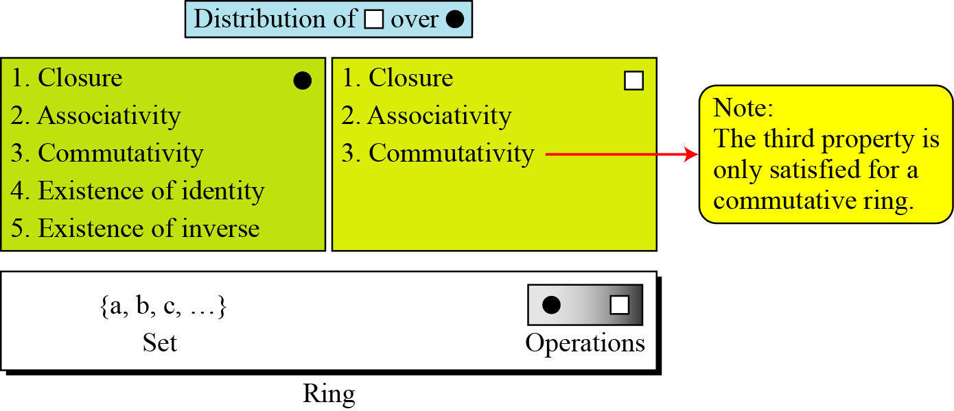
Ring(cont.)
Commutative Ring- is a ring in which the commutative property is also satisfied for the second operation.

Slide 27
Ring(cont.)
The set Z with two operations, addition and multiplication, is a commutative ring.
We show it by R = <Z, +, ×>.
Addition satisfies all of the five properties; multiplication satisfies only three properties.

Slide 28
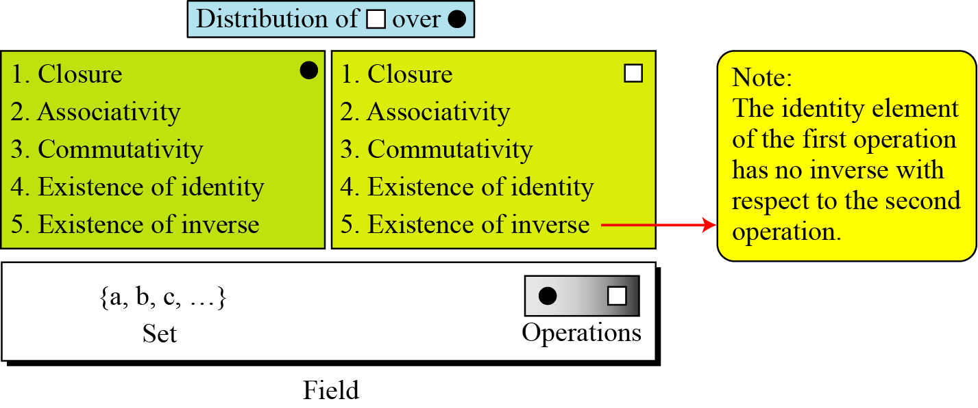
Field
A field, denoted by F = <{…}, •, > is a commutative ring in which the second operation satisfies all five properties defined for the first operation except that the identity element of the first operation has no inverse with respect to the second operation.

Slide 29
Field(cont.)
Finite Fields
Only finite fields are extensively used in cryptography.
It is a field with finite number of elements, are very important structures in cryptography.
Galois showed that for a field to be finite, the number of elements should be p^{n}, where p is a prime and n is a positive integer.
A Galois field, GF(p^{n}), is a finite field with p^{n} elements.

Slide 30
Field(cont.)
GF(p) Fields
When n = 1, we have GF(p) field.
This field can be the set Z_{p}, {0, 1, …, p − 1}, with two arithmetic operations (addition and multiplication).
In this set each element has an additive inverse and that nonzero elements have a multiplicative inverse (no multiplicative inverse for 0).

Slide 31
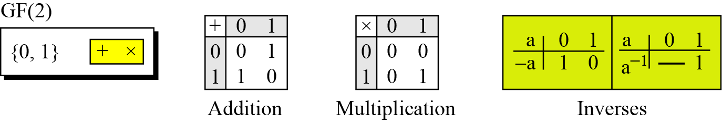
Field(cont.)
A very common field in this category is GF(2) with the set {0, 1} and two operations, addition and multiplication.
GF(2) field

Slide 32
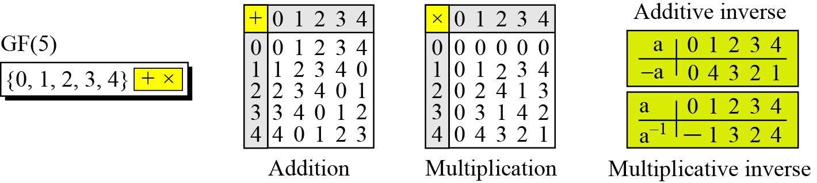
Field(cont.)
We can define GF(5) on the set Z5 (5 is a prime) with addition and multiplication operators.
GF(5) field

Slide 33
Summary:

Slide 34
GF(2^{n}) FIELDS
In cryptography, we often need to use four operations(addition,subtraction,multiplication,and division).
In other words, we need to use fields.
However, when we work with computers, the positive integers are stored in the computers as n-bit words in which n is usually 8,16,32 and so on.
Range of integers is 0 to 2^{n} – 1
Hence modulus is 2^{n}
What if we want to use field???? <there are two choices>

Slide 35
GF(2^{n}) FIELDS (cont.)
Choice 1
Use GF(p), with the set Zp, where p is the largest prime number less than 2^{n}
But the problem ???
It is inefficient because we can not use the integers from p to 2^{n} -1.
Example- if n=4,the largest prime less than 2⁴ is 13. this means we cannot use integers 13,14, and 15.
If n=8 ????????
Choice 2
Use GF(2^{n})
Use a set of 2^{n} elements
The elements in this set are n-bit words
E.g. for n=3, the set is {000,001,010,011,100,101,110,111}

Slide 36
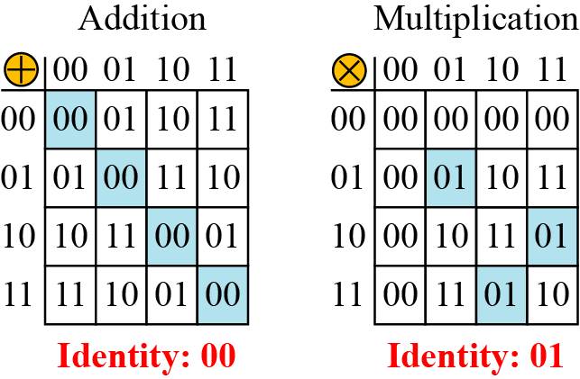
GF(2^{n}) FIELDS (cont.)
Let us define a GF(2²) field in which the set has four 2-bit words: {00, 01, 10, 11}.
We can redefine addition and multiplication for this field in such a way that all properties of these operations are satisfied. Addition and multiplication are defined in terms of polynomials.
An example of GF(2²) field

Slide 37
Polynomials
We can directly define the rules for addition and multiplication operations on n-bit words that satisfy the properties in GF(2^{n}).
A polynomial of degree n − 1 is an expression of the form
where x^{i} is called the ith term and a_{i} is called coefficient of the ith term.

Slide 38
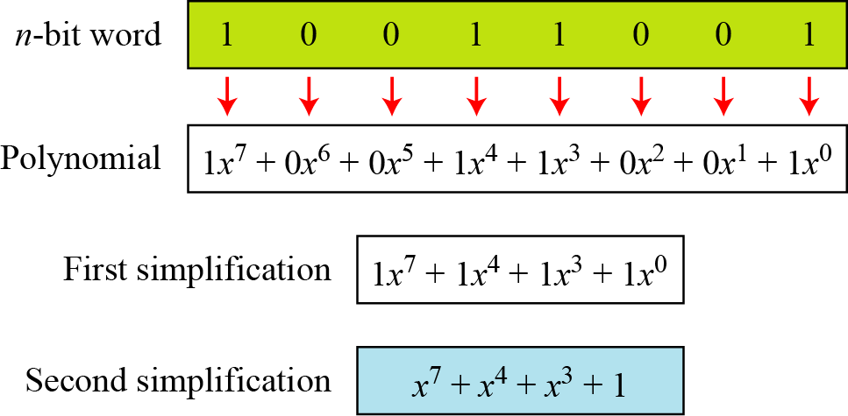
Polynomials (cont.)
We can represent the 8-bit word (10011001) using a polynomial.

Slide 39
Polynomials (cont.)
Find the 8-bit word related to the polynomial x⁵ + x² + x, we first supply the omitted terms.
Since n = 8, it means the polynomial is of degree 7. The expanded polynomial is,
This is related to the 8-bit word 00100110.

Slide 40
Polynomials (cont.)
Operations on polynomials
Actually involves two operations
Operation on coefficients and operation on polynomials
Hence, need to define two fields
What for coefficient??
What for polynomials???

Slide 41
Polynomials (cont.)
Operations on polynomials
Actually involves two operations
Operation on coefficients and operation on polynomials
Hence, need to define two fields
What for coefficient??
What for polynomials???
Coefficients are made of 0 or 1; we can use GF(2) and GF(2^{n}) for polynomials….

Slide 42
Polynomials (cont.)
Modulus
Why Modulus?
Addition of two polynomials never creates a polynomial out of the set.
However, multiplication of two polynomials may create a polynomial with degree more than n-1.
This means we need to divide the result by a modulus and keep only the remainder, as we deed in modular arithmetic.
For the sets of polynomials in GF(2^{n}), a group of polynomials of degree n is defined as the modulus.

Slide 43
Polynomials (cont.)
irreducible polynomials.
The modulus in this case acts as a prime polynomial , which means no polynomial in the set can divide this polynomial
A prime polynomial can not be factored into a polynomial with degree of less than n

Slide 44
Polynomials (cont.)
Example
Let us do (x⁵ + x² + x) ⊕ (x³ + x² + 1) in GF(2⁸). We use the symbol ⊕ to show that we mean polynomial addition. The following shows the procedure:
<keep the uncommon term and delete the common term>

Slide 45
Polynomials (cont.)
Short cut method
Addition in GF(2) means the exclusive-or (XOR) operation.
So we can exclusive-or the two words, bits by bits, to get the result.
In the previous example, x⁵ + x² + x is 00100110 and x³ + x² + 1 is 00001101.
The result is 00101011 or in polynomial notation x⁵ + x³ + x + 1.

Slide 46
Polynomials (cont.)
Multiplication
The coefficient multiplication is done in GF(2).
The multiplying x^{i} by x^{j} results in x^{i+j}.
The multiplication may create terms with degree more than n − 1, which means the result needs to be reduced using a modulus polynomial.

Slide 47
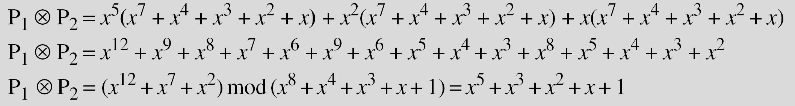
Polynomials (cont.)
Example
Find the result of (x⁵ + x² + x) ⊗ (x⁷ + x⁴ + x³ + x² + x) in GF(2⁸) with irreducible polynomial (x⁸ + x⁴ + x³ + x + 1). <
To find the final result, divide the polynomial of degree 12 by the polynomial of degree 8 (the modulus) and keep only the remainder.

Slide 48
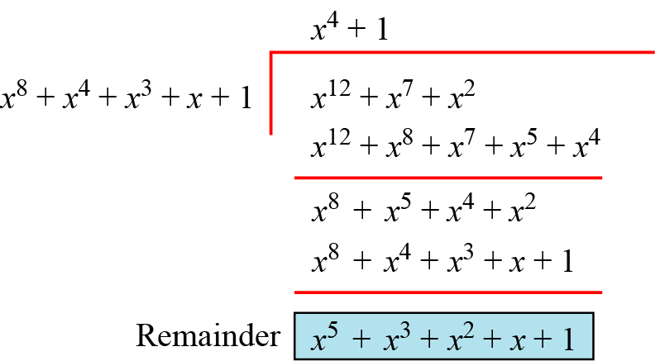
Polynomials (cont.)
Polynomial division with coefficients in GF(2)

Slide 49
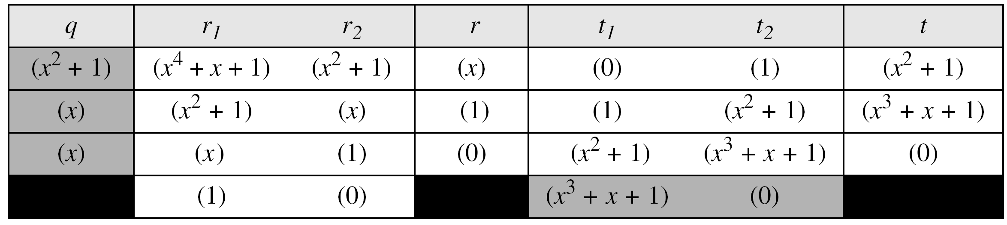
Polynomials (cont.)
Example:
In GF (2⁴), find the inverse of (x² + 1) modulo (x⁴ + x + 1).
Finding multiplicative inverse- use extended Euclidean Algorithm
Solution
The answer is (x³ + x + 1) <How to proof the answer>

Slide 50
Polynomials (cont.)
Example:
In GF(2⁸), find the inverse of (x⁵) modulo (x⁸ + x⁴ + x³ + x + 1).
Solution

Slide 51
Polynomials (cont.)
A better algorithm: Obtain the result by repeatedly multiplying a reduced polynomial by x.
Example:
Find the result of multiplying P₁ = (x⁵ + x² + x) by P₂ = (x⁷ + x⁴ + x³ + x² + x) in GF(2⁸) with irreducible polynomial (x⁸ + x⁴ + x³ + x + 1)

Slide 52
Polynomials (cont.)
Solution:
We first find the partial result of multiplying x⁰, x¹, x², x³, x⁴, and x⁵ by P₂. Note that although only three terms are needed, the product of x^{m} ⊗ P₂ for m from 0 to 5 because each calculation depends on the previous result.

